Slide 1
RETAIL ORDER & INVENTORY MANAGEMENT SYSTEM
- Group 3-
Simran Bawaskar
Saloni Bhutada
Aman Maheshwari
Reha Patel
Niraj Sai Prasad
Sindhu Swaroop

Slide 2

GITHUB CONTRIBUTORS

Slide 3
TEAM CONTRIBUTION
Simran Bawaskar - Views, Reports
Saloni Bhutada - Creation of customer tables, Triggers, Reports
Aman Maheshwari - Creation of customer tables, Triggers, Reports
Reha Patel - Creation of order tables, Reports, Views, Indexes
Niraj Sai Prasad - Creation of item tables, Writing stored procedures for order tables, & functions, Triggers
Sindhu Swaroop - Creation of item tables, Writing stored procedures for item tables and customer tables

Slide 4
PROBLEM STATEMENT
In the retail industry, it is vital that companies are able to keep up with the supply and demand on products they are offering
Some companies may choose to keep track of this supply and demand through physical books and paperwork
This type of tracking and management can result in problems like insufficient storage space, misplaced orders by human error, and overall customer dissatisfaction

Slide 5
PROPOSED SOLUTION
Our proposed solution demonstrates how a retail company that sells electronic items goes about digitally managing inventory based on orders that are fulfilled and returned
We allow customers to create accounts within our system that store data such as first name, last name, address, etc.
This data is used when a customer creates an order with different items to ensure that the right orders are being associated with the right customers
When an order is placed, we will make sure that the correct amount of each item in the order is removed from the inventory
When a customer wants to return an item, we also have the capability to create a return order and update the inventory of the item

Slide 6
KEY FEATURES
Customer account creation, modification, deletion
Multiple item order creation
Single item return
Partial payment using multiple payment methods
Item review creation, modification, deletion
Trigger for updating item status to 0 when item quantity goes to zero

Slide 7
IMPLEMENTED CONCEPTS
Tables
Views
Indexes
Triggers
Stored procedures, functions
Execution of stored procedures, functions
Reports

Slide 8
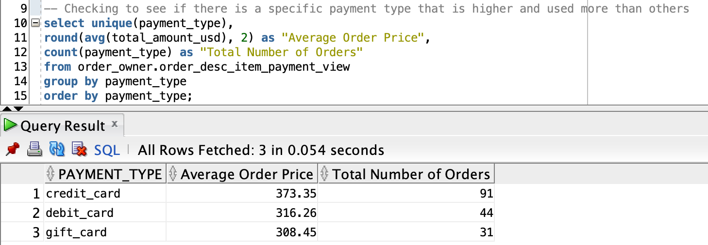
REPORT 1

Slide 9
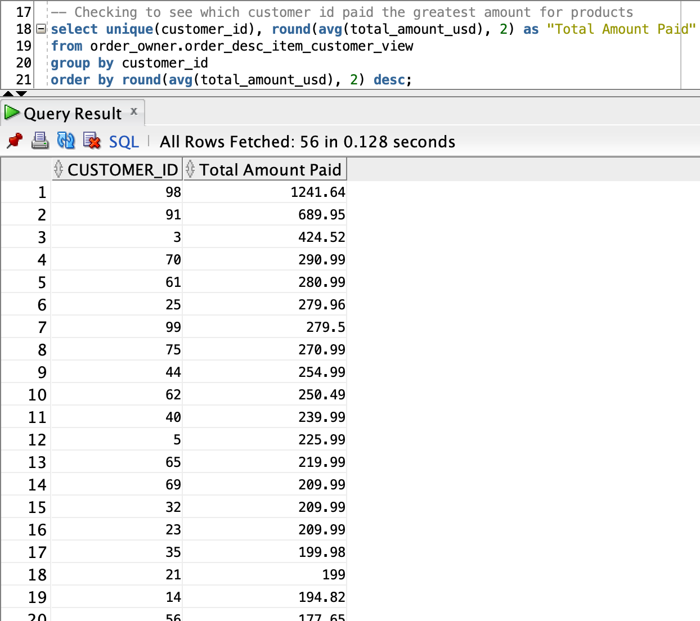
REPORT 2

Slide 10
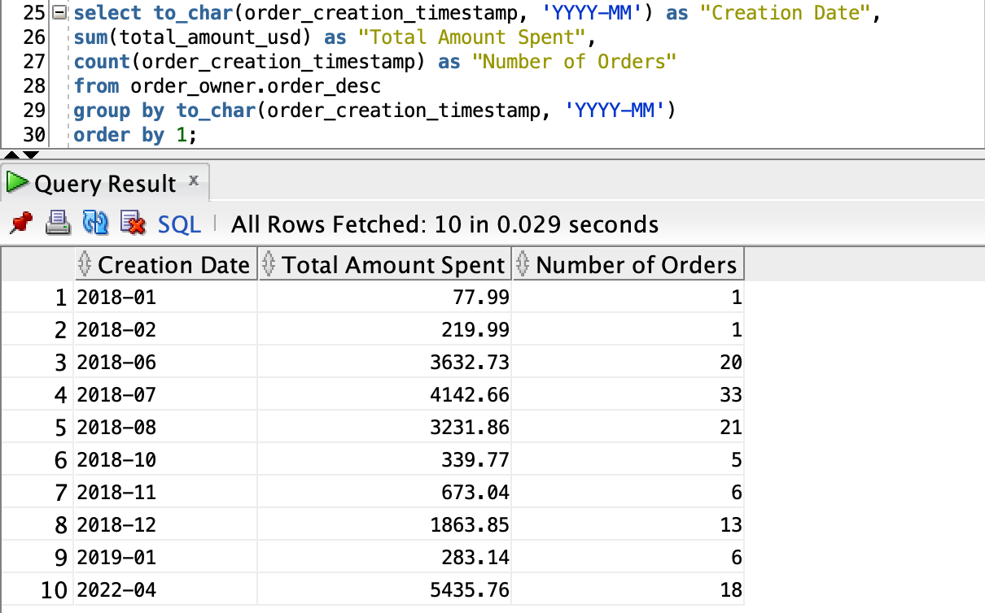
REPORT 3

Slide 11
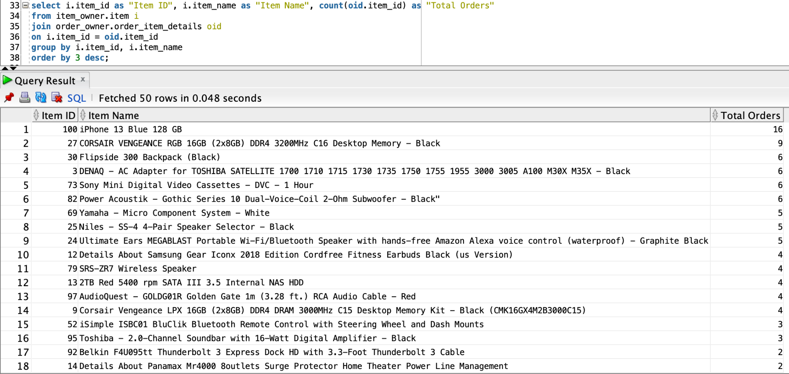
REPORT 4

Slide 12
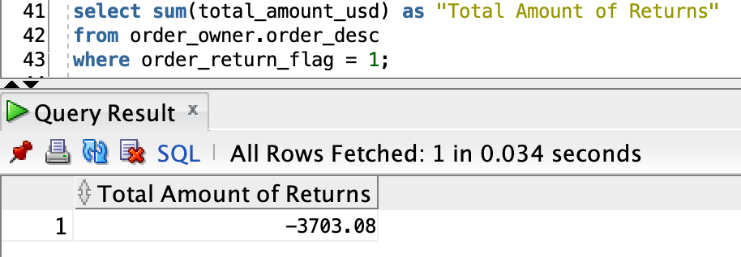
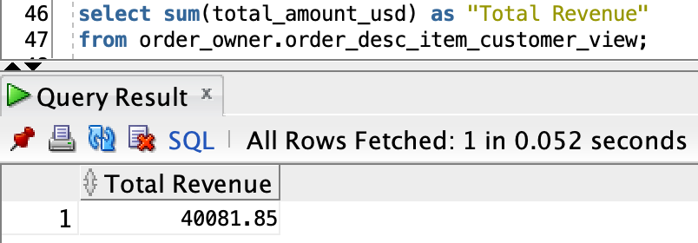
REPORT 5

Slide 13
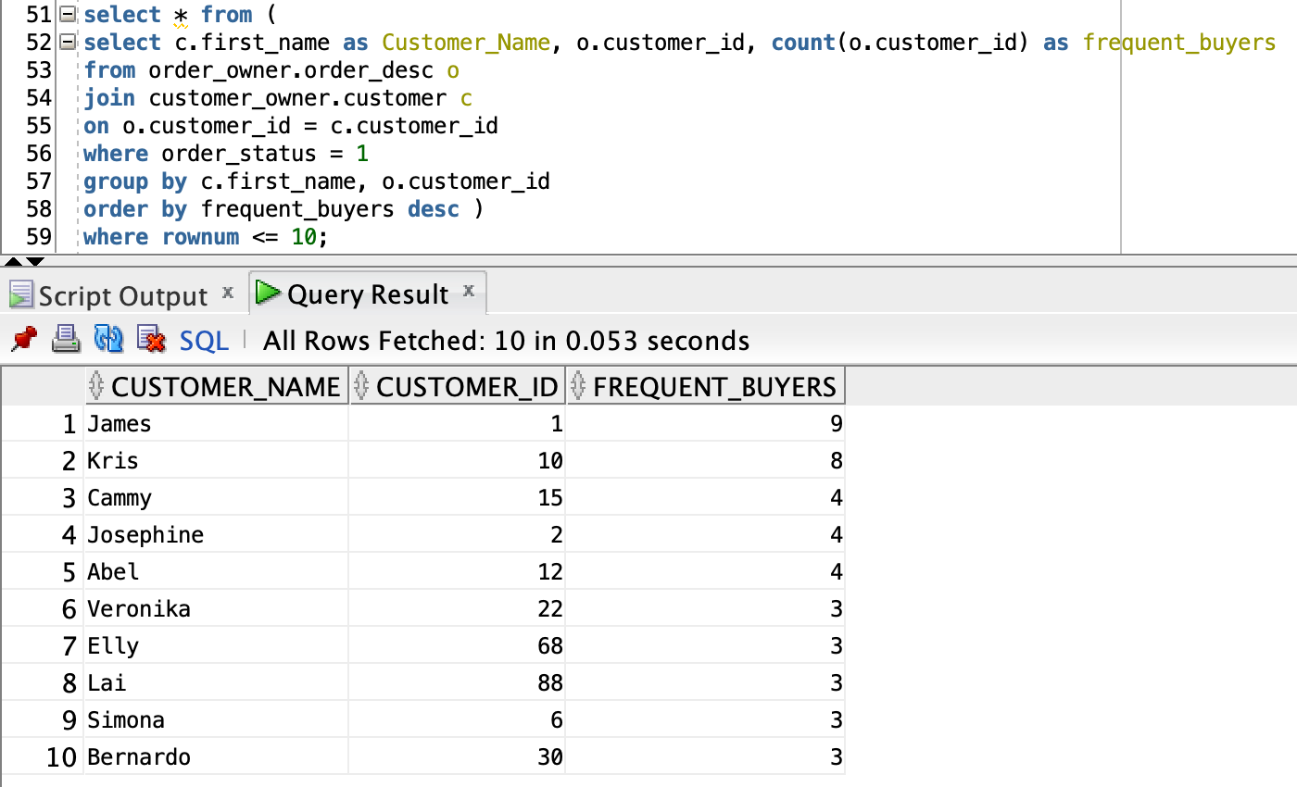
REPORT 6

Slide 14
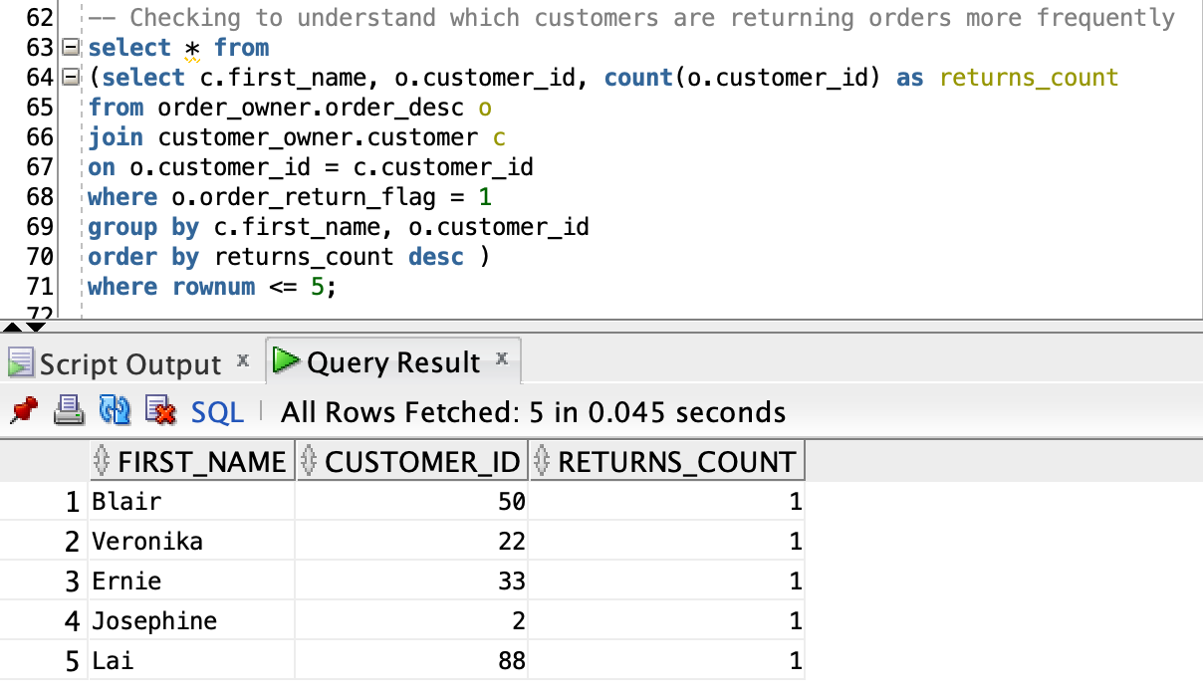
REPORT 7

Slide 15
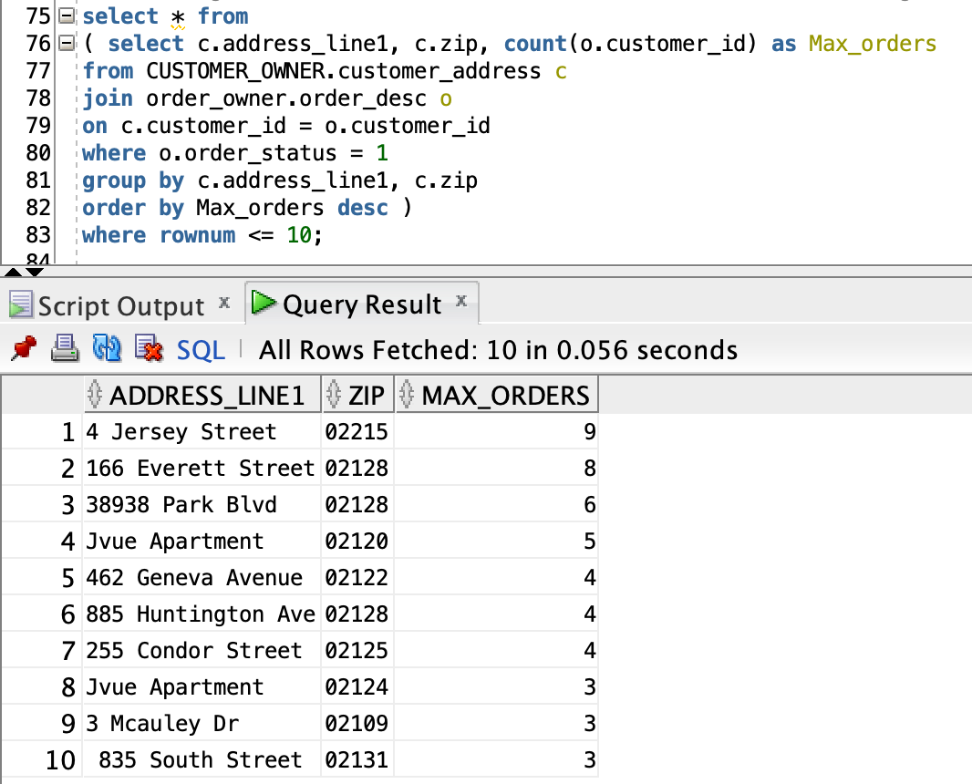
REPORT 8

Slide 16
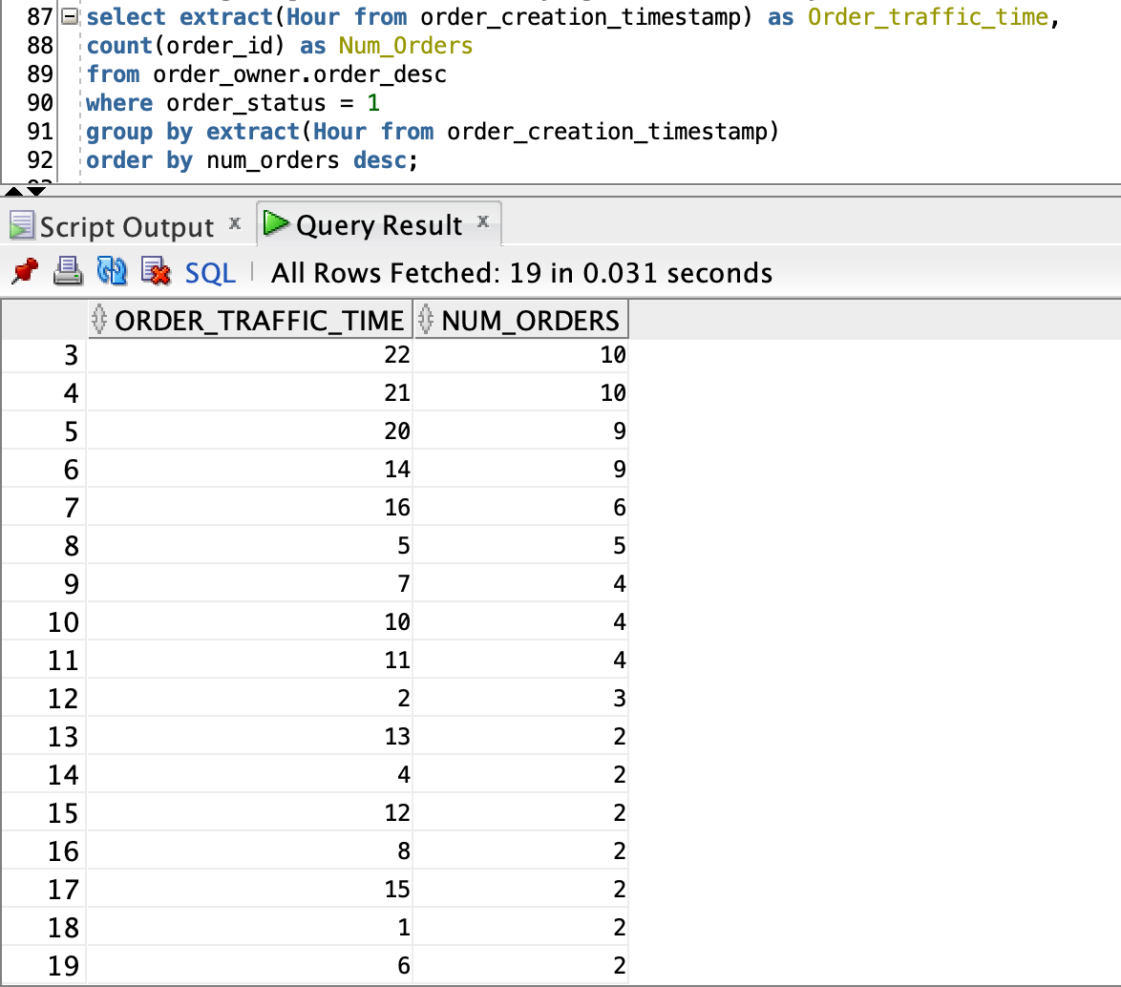
REPORT 9

